Slide 1

SAS Meets the Classroom
STAT305 BIOSTATISTICS
Modeling Factors Influencing Student Academic Performance Using Logistic Regression
Asanda Ndlela
Karina Hemraj
Mohammed Usayd Ismail
Swelihle Mhlongo
Siphiwo Sandiso Hlabisa
Notes:
Slide 1 ( Title of our project , the aim of our study and group members)

Slide 2


“Students have always been trying to pass. We just have more variables now.”
Notes:
Slide 2

Slide 3
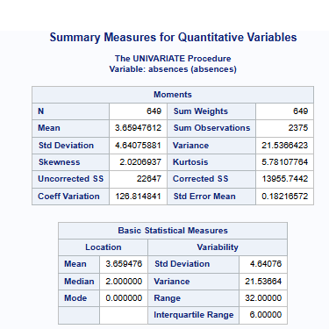
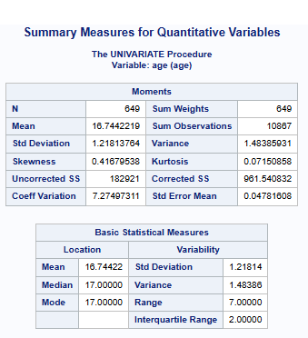
Understanding the student performance dataset
Variable | Measurement Scale
Gender (Student’s gender) | Nominal
Age (Student’s age) | Ratio
Address (Student’s home address type) | Nominal
Famsize (Family size) | Nominal
Pstatus (Parent’s cohabitation status) | Nominal
Medu (Mother’s education) | Ordinal
Fedu (Father’s education) | Ordinal
Mjob (Mother’s job) | Nominal
Fjob (Father’s job) | Nominal
Higher (Wants to take higher education) | Nominal
Internet (Internet access at home) | Nominal
Health (Current health status index) | Ordinal
Absences (Number of school absences) | Ratio
Final grade | Nominal
The table on the right shows each variable with its measurement scale. The response variable of interest is Final grade.

Slide 4
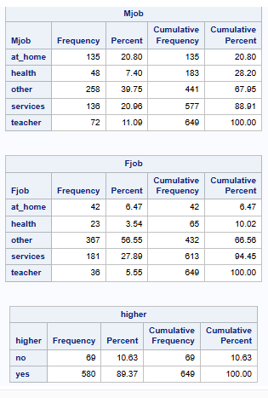
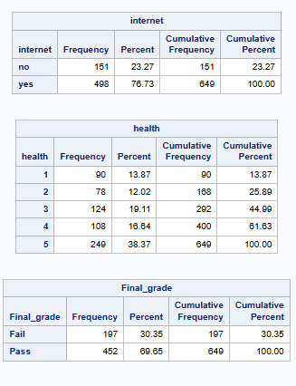
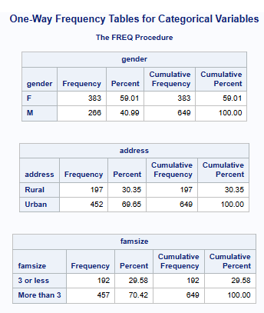
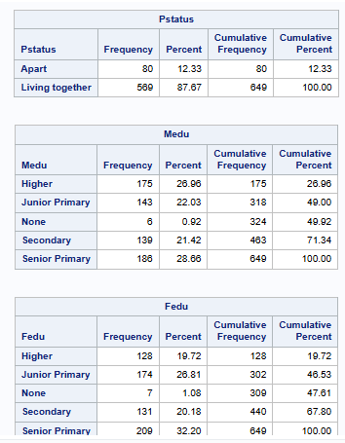
Identifying relevant categorical variables
Using the one-way tables below, we find that the variables of; gender, address, famsize, Pstatus, higher, internet and Final_grade(Variable of interest), have 2 categories and therefore means that those are the variables with not many categories. The other variables have 5 and more categories.

Slide 5
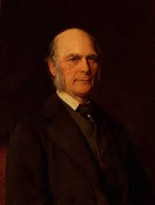
“Statistics: Turning confusion into tables since the 1800s.”
“I invented regression, now you’ll use it to predict passing.”

Slide 6
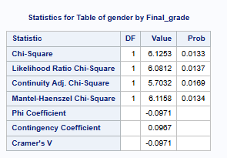
Two-way test of association for each of the relevant categorical explanatory variables and the response of interest.
Gender:
H₀ (Null Hypothesis): There is no association between the gender variable and the final grade.
H₁ (Alternative Hypothesis): There is an association between the gender variable and the final grade.
Significance Level (α): 0.05
Conclusion: Since the p-value (0.0133) is less than 0.05, we reject the null hypothesis. There’s a
significant association between gender and final grade. It concludes that male students have a higher
failures compared to female students.

Slide 7
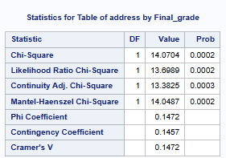
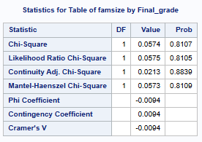
ADDRESS :
H₀ (Null Hypothesis): There is no association between the address variable and the final grade.
H₁ (Alternative Hypothesis): There is an association between the address variable and the final
grade.
Significance Level (α): 0.05
Conclusion: Since the p-value (0.0002) is less than 0.05, we reject the null hypothesis. There is a
significant association between the address type and final grade. It shows that the proportion of
urban students have a higher final grade compared to rural students.
FAMSIZE :
  H₀ (Null Hypothesis): There is no association between the famsize variable and the final grade.
  H₁ (Alternative Hypothesis): There is an association between the famsize variable and the final
  grade.
Significance Level (α): 0.05
Conclusion: Since the p-value (0.8107) is more than 0.05, we do not reject the null hypothesis.
There isn’t a significant association between the famsize and final grade. It shows that the pass rate
of students who have 3> had a pass rate of 70.31% and students with a family size of 3< had a pass
rate of 69.37%, which only has a small difference.

Slide 8
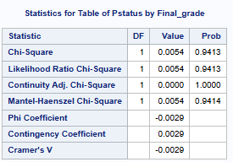
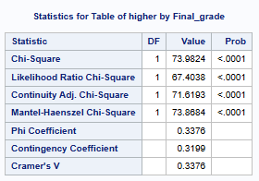
PSTATUS :
H₀ (Null Hypothesis): There is no association between the pstatus variable and the final grade.
H₁ (Alternative Hypothesis): There is an association between the pstatus variable and the final grade.
Significance Level (α): 0.05
Conclusion: Since the p-value (0.9413) is more than 0.05, we do not reject the null hypothesis. There isn’t a
significant association between the pstatus and final grade. It shows that the pass rate with parents living apart (70%)
and those with parents living together (69.9%) has a very small difference.
HIGHER :
H₀ (Null Hypothesis): There is no association between the higher variable and the final grade.
H₁ (Alternative Hypothesis): There is an association between the higher variable and the final grade.
Significance Level (α): 0.05
Conclusion: Since the p-value (<0.0001) is less than 0.05, we reject the null hypothesis. There is a significant
association between higher and final grade. It shows that students with no intention of furthering their education had a
high failure rate (only 24.64% pass rate) and students with the intention of furthering their education had a higher pass
rate (75%).

Slide 9
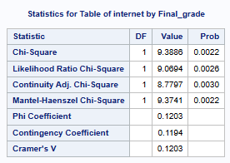
INTERNET :
H₀ (Null Hypothesis): There is no association between the internet
variable and the final grade.
H₁ (Alternative Hypothesis): There is an association between the
internet variable and the final grade.
Significance Level (α): 0.05
Conclusion: Since the p-value (0.0022) is less than 0.05, we reject
the null hypothesis. There is a significant association between
having access to internet at home and a student’s final grade. It shows
that students with no access to internet at home have a pass rate of
59.6% and students with access to
internet at home have a pass rate of 72.69%.

Slide 10

DO YOU THINK YOU CAN FIND SIMILAR ASSOCIATION RESULTS USING A REGRESSION MODEL?
A logistic regression model would be cool for this dataset .

Slide 11
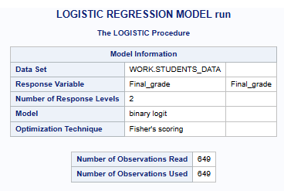
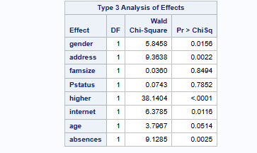
LOGISTIC REGRESSION MODEL
The inclusion of “Age” and “Absences” could have an effect on our model when comparing the p-values to that of test of association but when comparing the significance of the variable we found that it is similar for both the model and the test of association. In the p-values there we some slight changes since the variables under the test of association had undjusted p-values unlike the logistic regression model. Remember a logistic regression adjusts for all included variables simultaneously, whereas a simple test of association usually looks at one variable at a time.

Slide 12
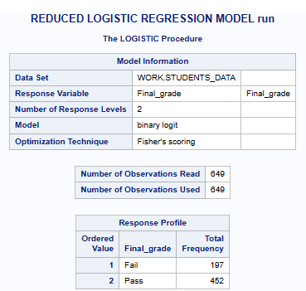
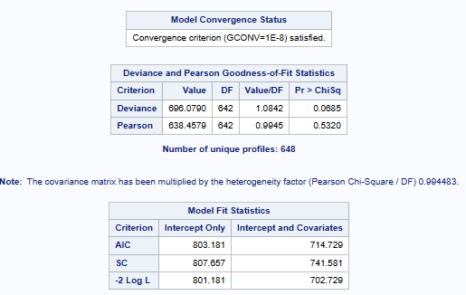
BEST FITTING MODEL
Now one thing we asked ourselves was would it be fair to have the previous regression model as our best-fitting model even though it has certain variables which has no significant association with our variable of interest. The answer was NO. Thus, since the p-values of “Age” , “Pstatus” and “Farmsize” has p-values greater than 0.05, the variables were removed from the model. We chose our best-fitting model based on the contribution of each predictor variable towards our variable of interest ”Final grade”.In our model there is no evidence of overdispersion since our Pearson Chi-Square ratio is 0,9945 which is almost 1.Thus, our p-values and std erros are very reliable.

Slide 13

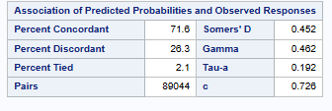
Accuracy of the model
“When your model finally runs without any errors”
Our model has an acceptable predictive ability, can distinguish well between students who fail and pass

Slide 14
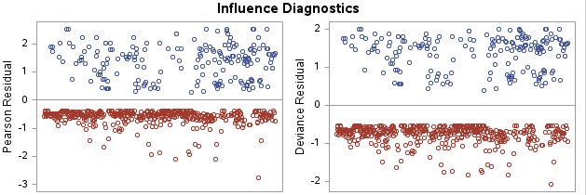
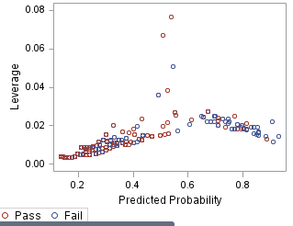
HOW DOES THE MODEL FIT ON THE DATA??
For the Pearson residuals : Most points fall between -2 and 2 , which means our observations are well fitted even though there are a few points outside this range.
For the laverage residual : Most laverage point are less than 0.04 which implies we have no serious high laverage issues. Thus , we can conclude that our observations’s predictor values are NOT very far from the mean.

Slide 15
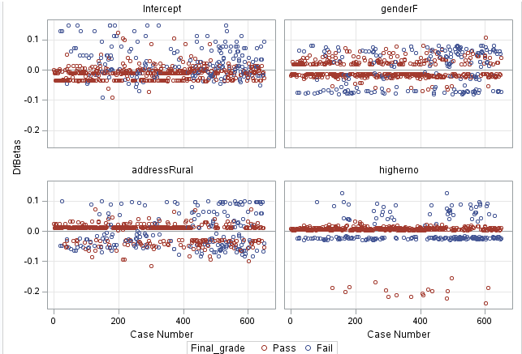
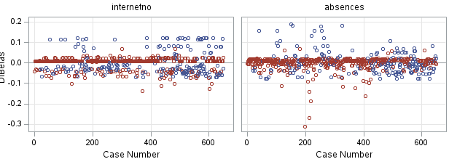
For DFBETAS :
(i) Intercept : Most points are clustered around 0 suggesting no case affects the intercept.The overall influence
seems decent.
(ii) GenderF : Most points are symmetrical around 0 , meaning there are no outliers. So that tells us that no student
was driving the effect of Gender.
(iii) AddressRural : A few points are around -1 and 1 indicating slightly higher influence thusbeing from urban/rural
has a noticeable effect.
(iv) HigherNo : We have 17 points below -0.1 , indicating students who don’t want to go to tertiary have stronger
influence.This variable shows more influence than the others.
(v) InternetNo : Most points are centred around 0, indicating minimal influence by individual observation.A few
points exceed -0.1 and 0.1 also suggesting limited influence by internet connection on final grade.
(vi) Absences : The points are centred around 0 , showing low influence for most cases. There are a few points with
strong influence, indicating a small number of students are affected by being absent, but the model remain strong.

Slide 16
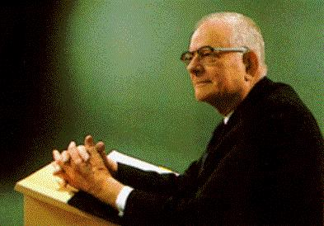
“Without data, you’re just another person with an opinion.”
W. Edwards Deming

Slide 17
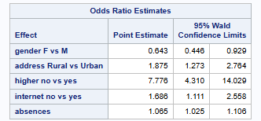
Factors that significantly contribute to a higher likelihood of the event of interest occurring.
Gender : OR=0/643< 1 and CI=(0.446, 0.929) does not include. Therefore, females are significantly less likely to fail compared to males. Gender significantly decreases likelihood.
Address : OR=1,875 >1 and CI=(1.273, 2.764) does not include 1. Individuals living in rural areas are significantly more likely to fail. Address significantly increases likelihood.
Higher : OR=7,776>1 and CI=(4.31, 14.029) DOES NOT CONTAIN 1. This suggest strong and significant effect. Students without higher education ambitions are more likely to fail. Higher significantly increases likelihood.

Slide 18

POV : When you remember
“ odds > 1 — students have a fighting chance!”

Slide 19
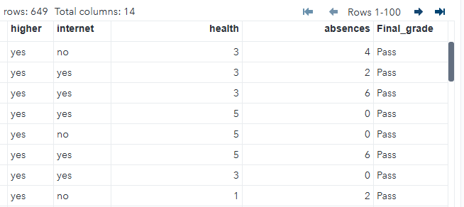
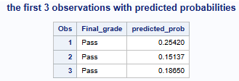
PREDICTING FOR THE FIRST 3 STUDENTS

Slide 20

FROM GROUP F

